Slide 1

Implementation of Self-learning Topic for Developing Interactive Mobile Application in Flutter Programming Learning Assistance System

Slide 2
1st Dionisius Damarta Yapenrui
Dept. of Information Technology
State Polytechnic of Malang
Malang, Indonesia
1931710111@student.polinema.ac.id
4th Indrazno Siradjuddin
Dept. of Electrical Engineering
State Polytechnic of Malang
Malang, Indonesia indrazno@polinema.ac.id
2nd Yan Watequlis Syaifudin
Dept. of Information Technology
State Polytechnic of Malang
Malang, Indonesia
qulis@polinema.ac.id
(corresponding author)
5th Nobuo Funabiki
Dept. of Elec. and Comm. Engineering
Okayama University
Japan, Indonesia
funabiki@okayama-u.ac.jp
3rd Noprianto
Dept. of Information Technology
State Polytechnic of Malang
Malang, Indonesia
noprianto@polinema.ac.id
6th Hidayati Nur Chasanah
Dept. of Information Technology
State Polytechnic of Malang
Malang, Indonesia
1931710028@student.polinema.ac.id

Slide 3
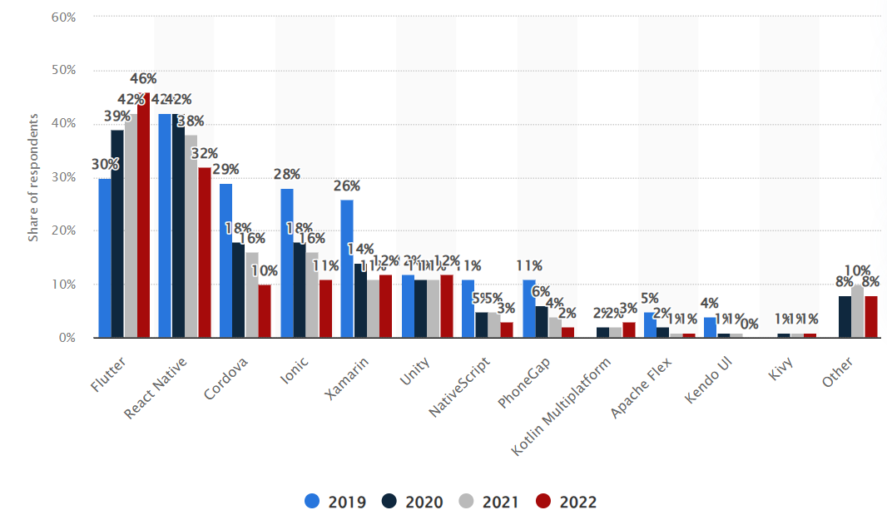
Flutter’s popularity in mobile app development, especially for interactive apps, has increased tremendously due to its flexibility and efficiency
https://www.statista.com/statistics/869224/worldwide-software-developer-working-hours

Slide 4

Introduction
The demand for mobile application programmers continues to increase, but there is a significant technology gap in learning mobile programming However, mobile programming is highly practical, and students often need hands-on support.

Slide 5
Related Work
In 2016, Jianxiong Gao et al. introduced a framework in an introductory programming course to collect student codes and apply industrial automated testing, which they deployed on five different C programming assignments, making test results easily understandable for students.
Alahmadi in 2022 proposed VID2META, a technique to help developers’ works by automatically extracting key programming elements like Java import statements and GUI details from Android screencasts and converting them into metadata.

Slide 6
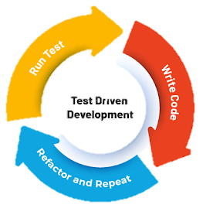
Test Driven Development
The practice of software development that emphasizes writing tests before writing actual code.

Slide 7
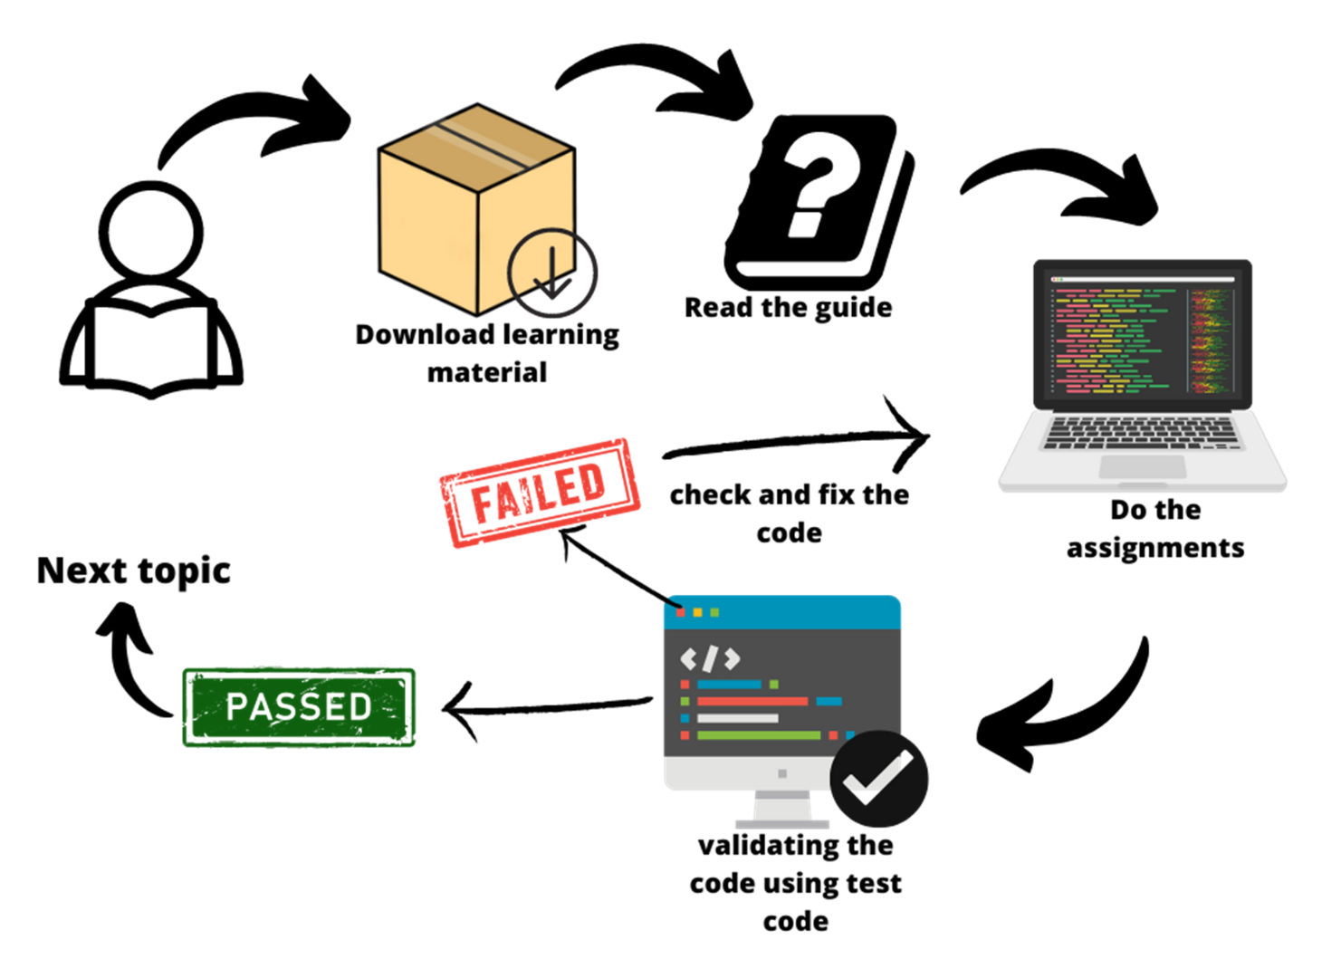
Learning Method

Slide 8

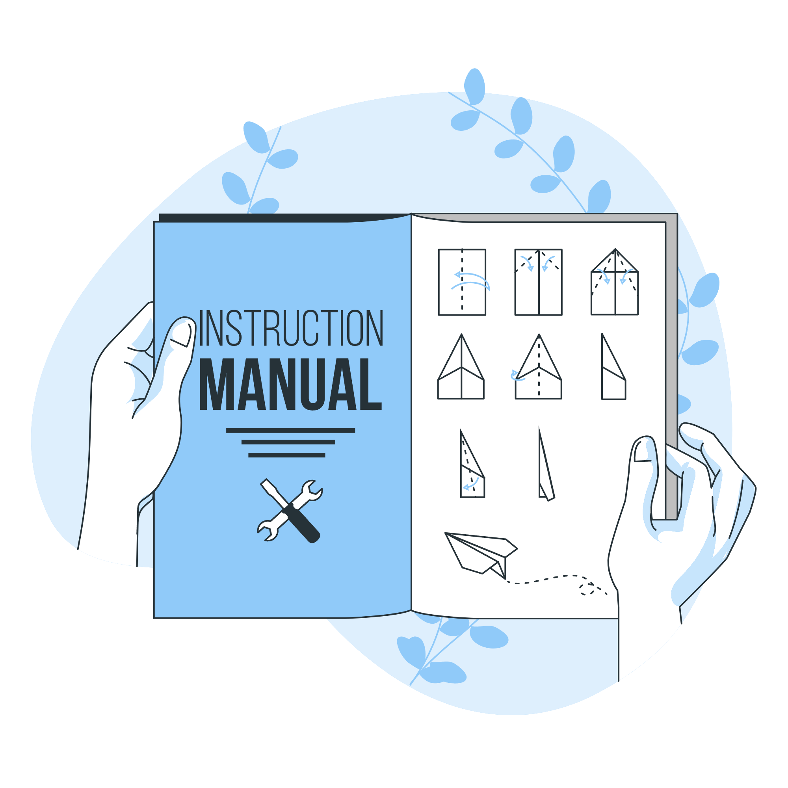
Learning Material
Guide File
Supplement File
Test Code
Set of instructions for students to follow
Contains assets and other materials which needed for tasks
Series of codes written in dart language used to verify codes produced by students

Slide 9
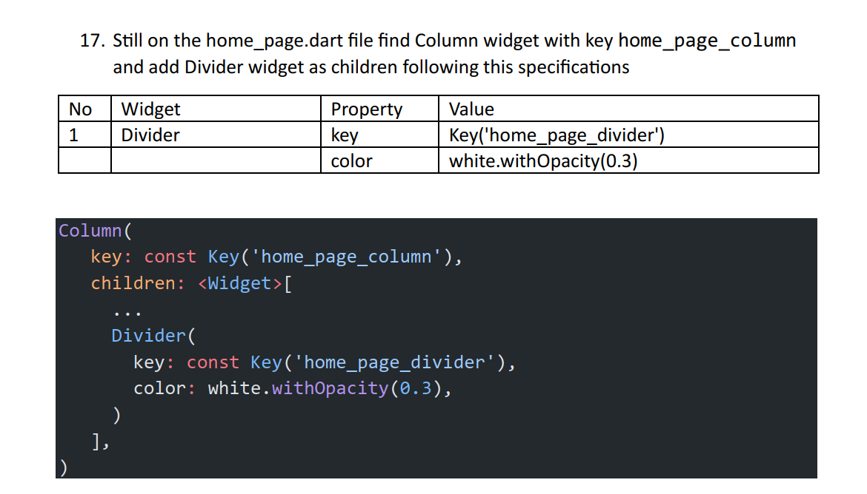
Example task from prepared Guide file

Slide 10
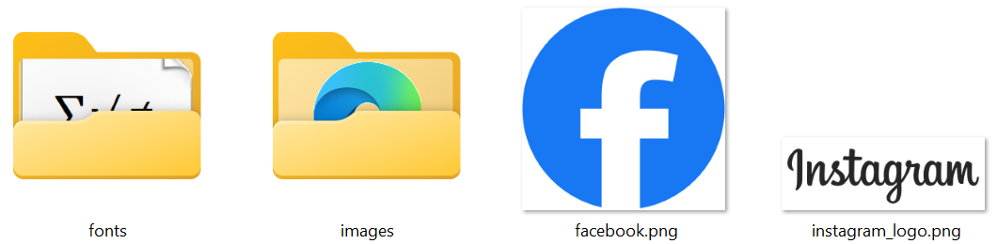
Example of supplement files that being used

Slide 11
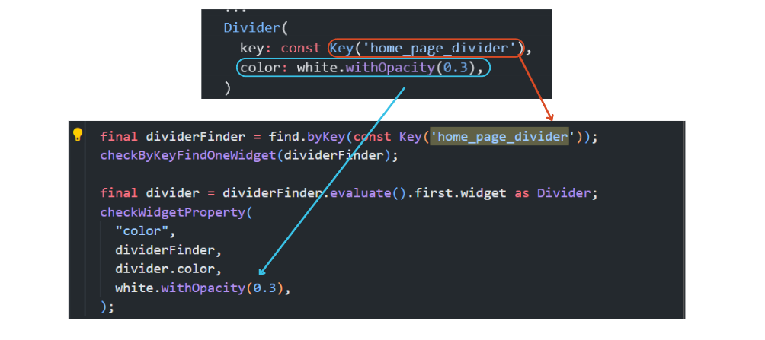
Example of test code

Slide 12
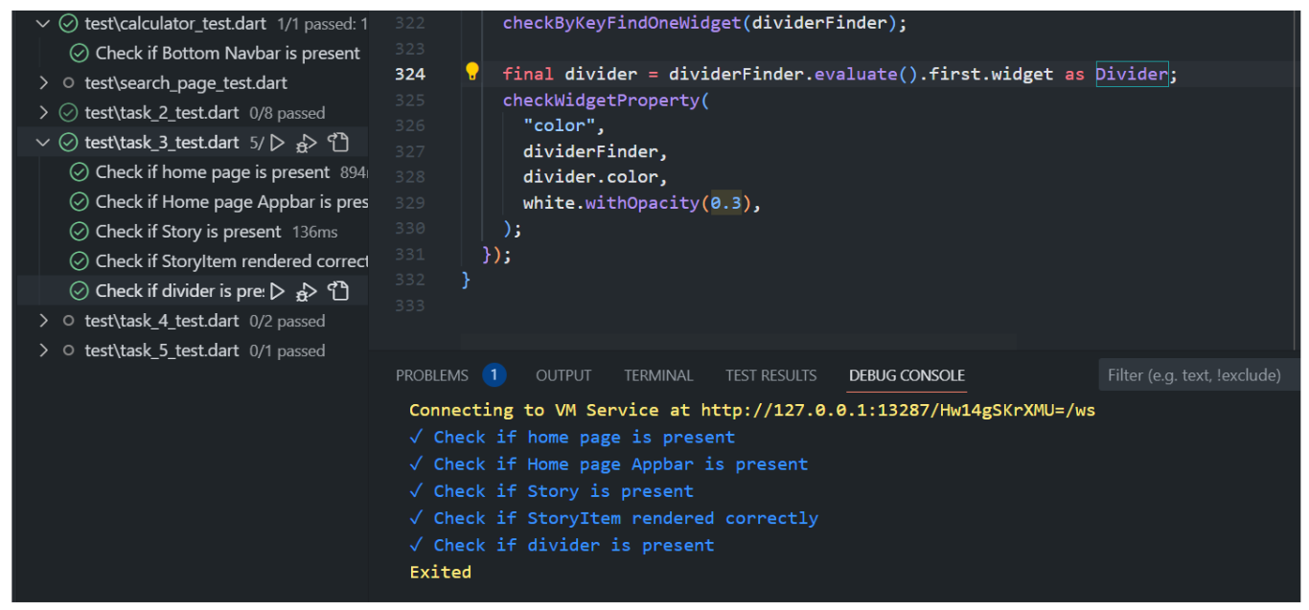
Test code success message

Slide 13
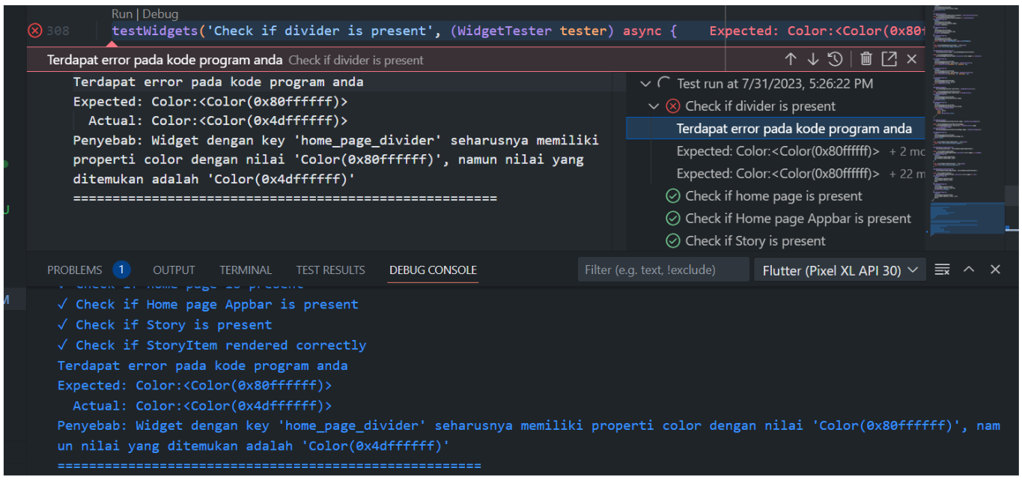
Test code failed message

Slide 14
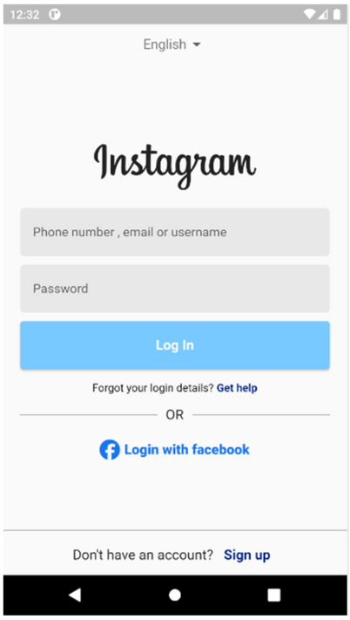
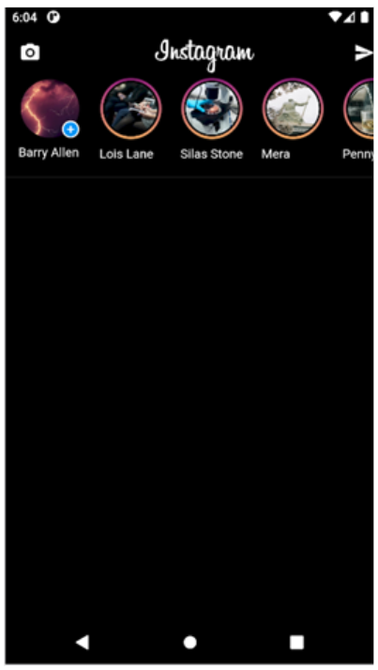
Study Case
Task 2
Task 3
Creating Instagram’s login screen
Creating Instagram’s home page (story list)

Slide 15
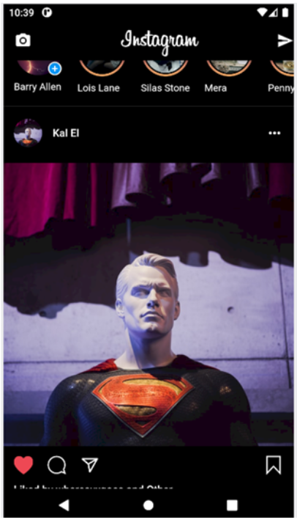
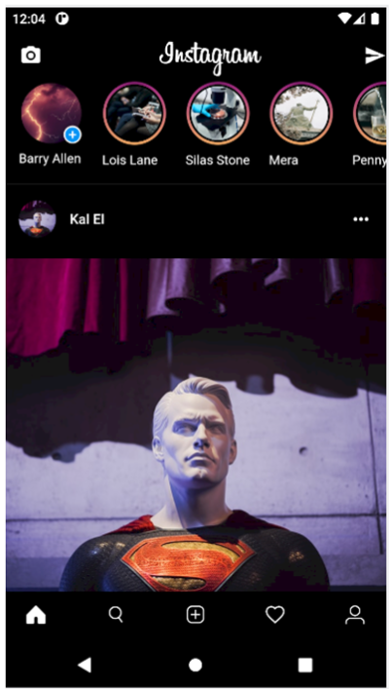
Study Case
Task 4
Task 5
Creating Instagram’s home page (post list)
Creating Instagram’s home page (bottom navigation bar)

Slide 16
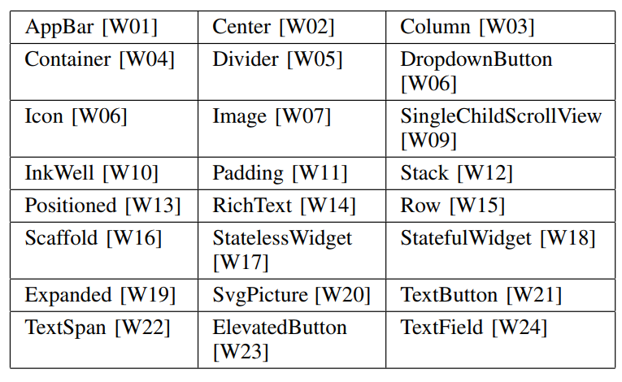
List of Adopted Widgets

Slide 17
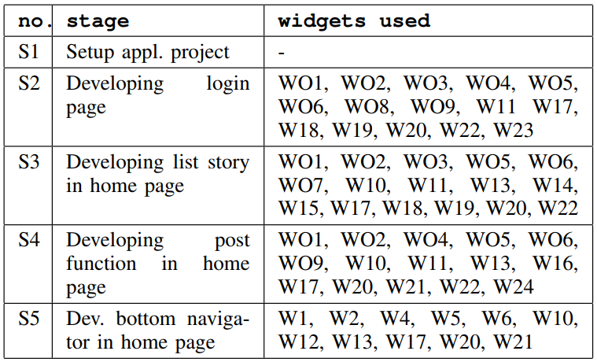
Learning Stages

Slide 18
Results
After three days of experimentation, results indicate a 100% success rate among 40 students who completed each stage (S1 to S5). The completion times varied, with Stage 5 being the quickest (8 minutes) and Stage 4 the longest (40 minutes). Average times, however, present a different perspective, with Stage 4 being the most time-consuming (average 100.9 minutes), followed by Stages 2 and 3. The differences in completion times suggest varying complexities or student familiarity with the assignments. Stage 1 and Stage 5 had significantly lower average times (31.8 and 43.9 minutes respectively), suggesting they were more straightforward tasks.

Slide 19
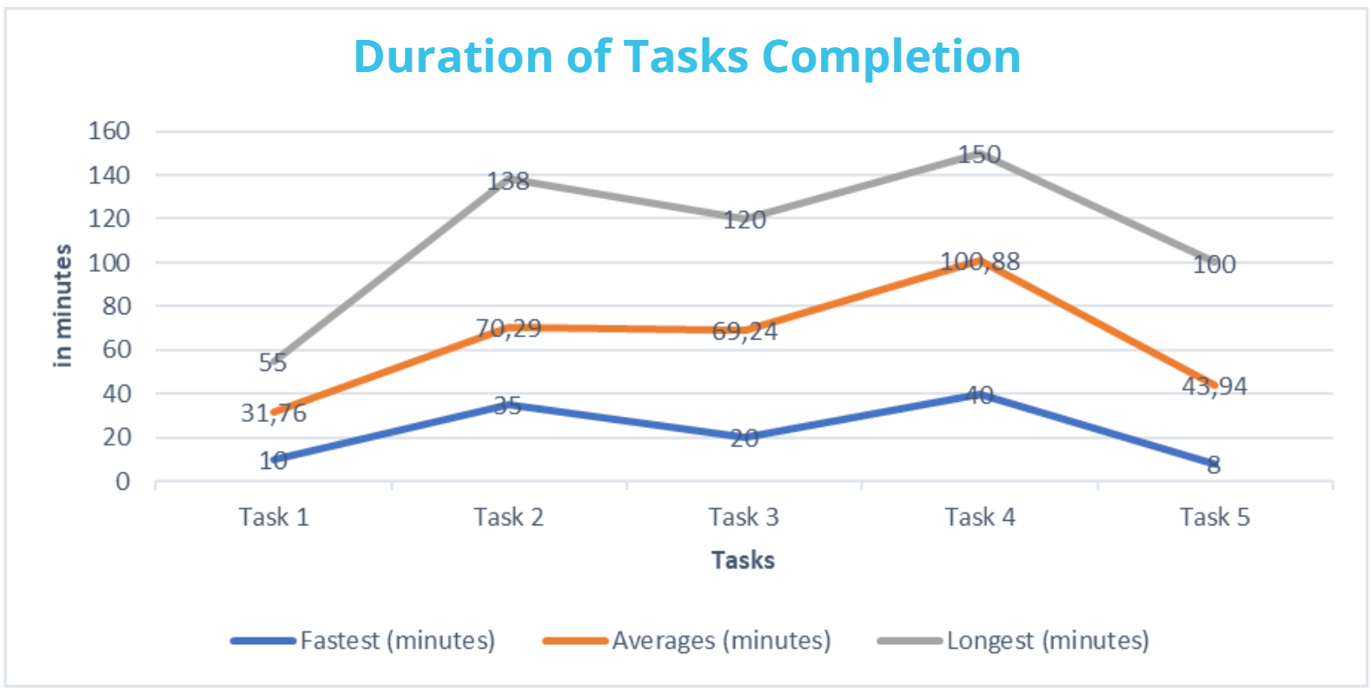
Learning Result

Slide 20
Feedback
Positive
"Extremely helpful as it’s easy to understand at every step-by-step stage.”
”The interactive Flutter application, especially the task of creating an Instagram-like interface, has helped me sharpen and improve my UI design skills.”
”Useful, as the tasks include tables that explain each code in detail.”
”The tasks provided are very beneficial for exploring various Flutter syntaxes, which are essential for developing Flutter-based applications.”
Suggestions
”Sufficient, but the steps in the guide could be further clarified.”
”Perhaps an explanation about the code could be added."

Slide 21
Thanks!

