Slide 1
IMPLEMENTATION OF DATA ANALYTICS IN PYTHON PROGRAMMING LEARNING ASSISTANCE SYSTEM
By
Noora Aulia Hidayat
NIM. 2041720046
Supervisor:
Yan Watequlis Syaifudin, ST., M.MT., Ph.D.
Retno Damayanti, S.Pd., M.T.

Slide 2
INTRODUCTION
The demand for Data Analytics in the business world is increasing. In 2023, there were 1,072 job postings related to the most sought-after skills, techniques, and degrees, as well as the current job market conditions on LinkedIn (Yosifova, 2023).
In programming learning without validation, students find it difficult to measure how well they understand the material. Similarly, identifying errors and finding mistakes.
To facilitate this, The lecturer have taken the initiative to develop a web-based learning platform equipped with automated code validation (Watequlis Syaifudin, 2021).

Slide 3
Research problem
How to measure the level of understanding of students in the Python Assistance System for Data Analytics Learning website?
How can this website assist students in self-learning Python programming for Data Analytics?
Objectives of the Research
Implementing Data Analytics Learning in Python Programming Assistance System
Assisting students in independently learning Python programming for Data Analytics.

Slide 4
Scoup of Research
Learning platform based on website
The platform using Google Colaboratory
Users are students of Politeknik Negeri Malang
Utilizing the Python programming languages
Learning materials related to Data Analytics include load data, data cleaning, data manipulation, data data visualization.

Slide 5
Previous Research
the Implementation of Basic Programming Learning in Python. This research is based on a website for easy access. The system is designed to facilitate students in independently learning the basics of Python programming. User-inputted code will be evaluated using Codewars (Yulvarisma, 2022),
Python Programming Learning Assistance System (PYPLAS) is developed to assist students in learning Python programming and reduce the workload for university instructors. It provides fill-in-the-blank exercises ranging from beginner to advanced levels, generated using a blank element selection algorithm.
According to a publication titled "Studying the Impact of Auto-Graders Giving Immediate Feedback in Programming Assignments" compiled by (Mitra, 2023), while students use immediate input from an auto-grader, it does not discourage them from developing independent testing skills. Furthermore, feedback enables students, particularly those from underrepresented groups (such as women), to learn more successfully and confidently.

Slide 6
RESEARCH METHODOLOGY
Time and Place: conducted at the State Polytechnic of Malang for 3 months, from April 2024 to July 2024.
Data Collection Method:
Responden: 40 Students of Information Technology Major at Politeknik Negeri Malang
Platform: - Google Colaboratory
- Google Drive
- Google Forms

Slide 7



VOLUNTEERS DATA AND TESTING
The total number of volunteers is 40 students from the Department of Information Technology at Politeknik Negeri Malang.
Testing Devices : Laptop or PC
Testing Time : 3 days

Slide 8
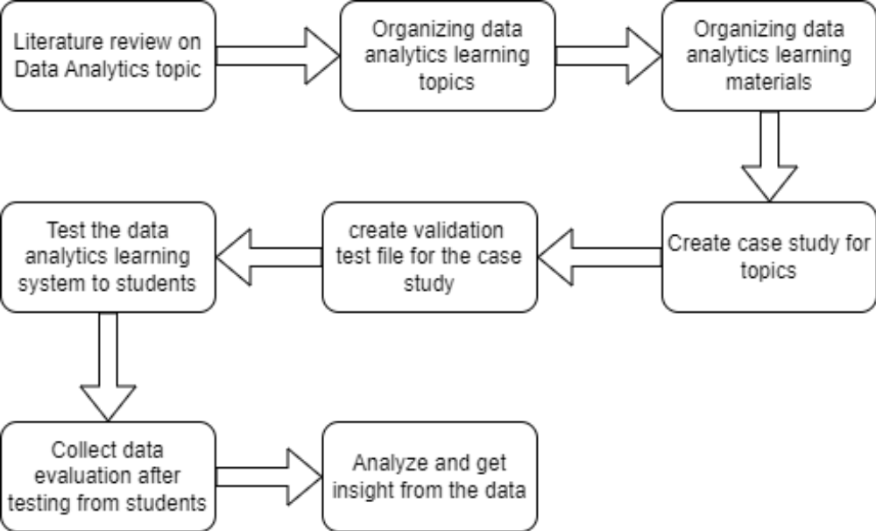
System Design
This research focuses on the application of Unit Testing using Codewars_test in the context of Data Analytics learning materials.

Slide 9
LEARNING MATERIALS
No | Experiment Name | Topic
1. | Get the dataset from url and read as CSV file. | Data Loading
2. | Display the Produk Online Store Data. | Data Loading
3. | Cleaning column name for real estate data. | Cleaning Dataset
4. | Handling missing values for Calories data. | Cleaning Dataset
5. | Cutting a NumPy 2D array on a specific coverage. | Data Manipulations
6. | Calculate Total Product Revenue. | Data Manipulations
7. | Selecting Specific Movies from Movie dataset. | Data Manipulations
8. | Analisa Measures of Variability pada customer's Age. | Data Manipulations
9. | Electronic Sales Analysis: Understanding Sales Trends Through Measures of Central Tendency. | Data Manipulations
10. | Visualizing the age distribution of the population based on age range using a Pie Chart. | Data Visualization

Slide 10
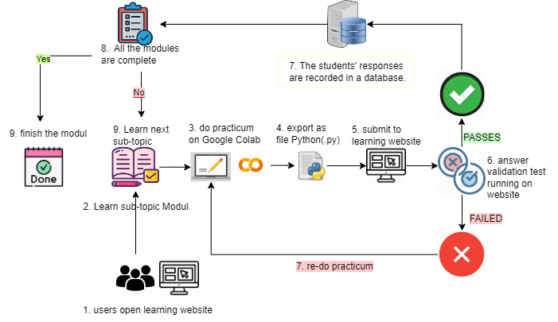
System Architecture Design

Slide 11
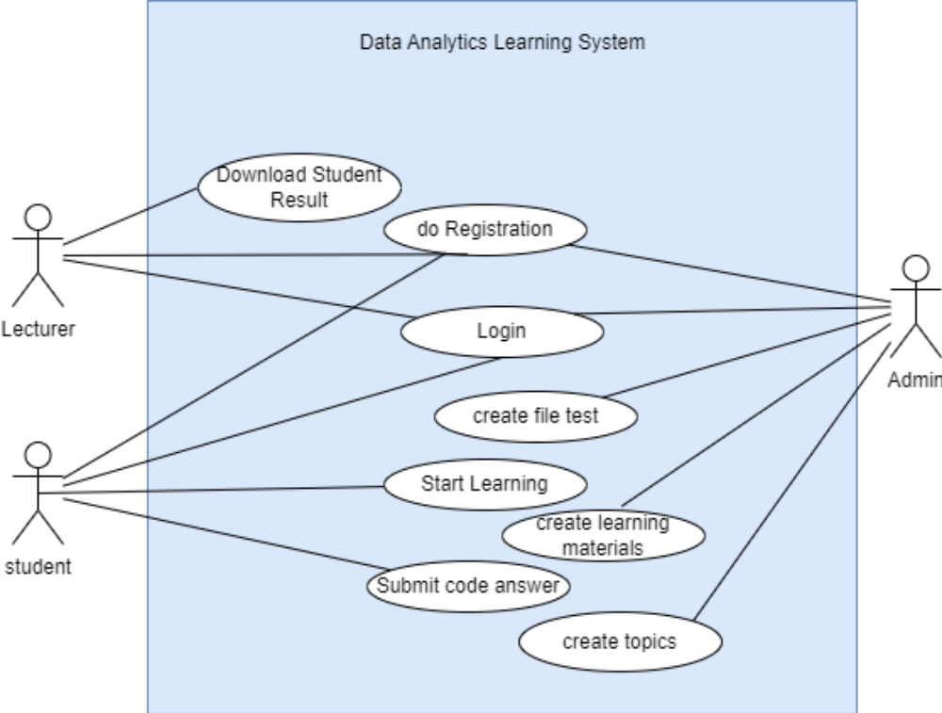
Use Case Diagram
the focus is limited to the development of use cases such as creating a topic, creating learning materials, and create file test.

Slide 12
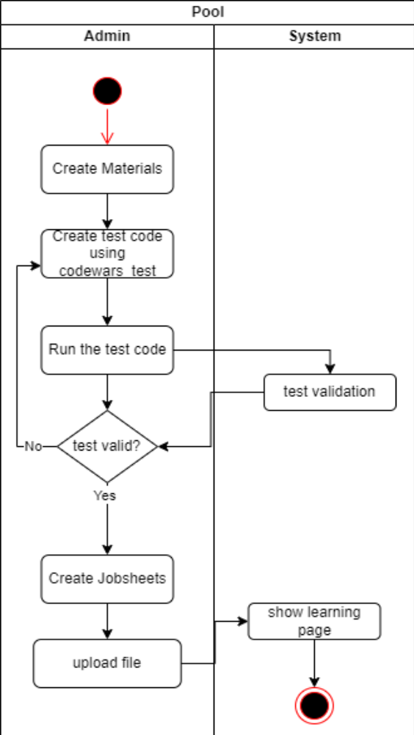
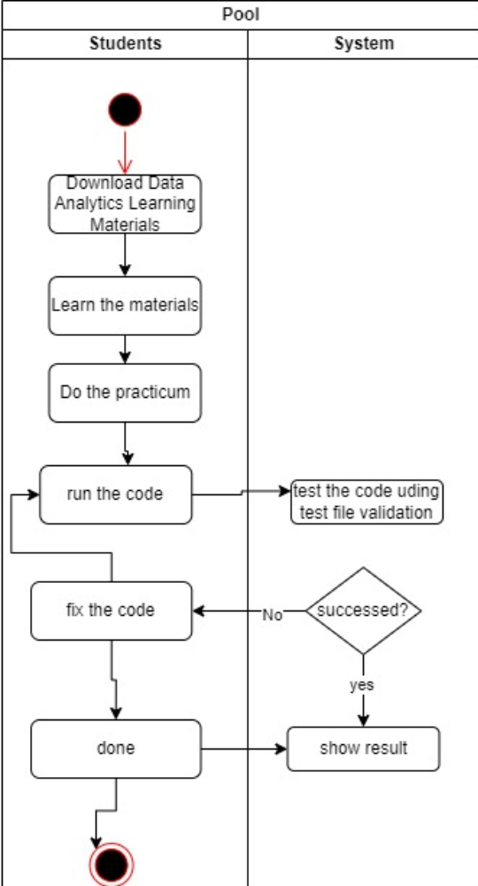
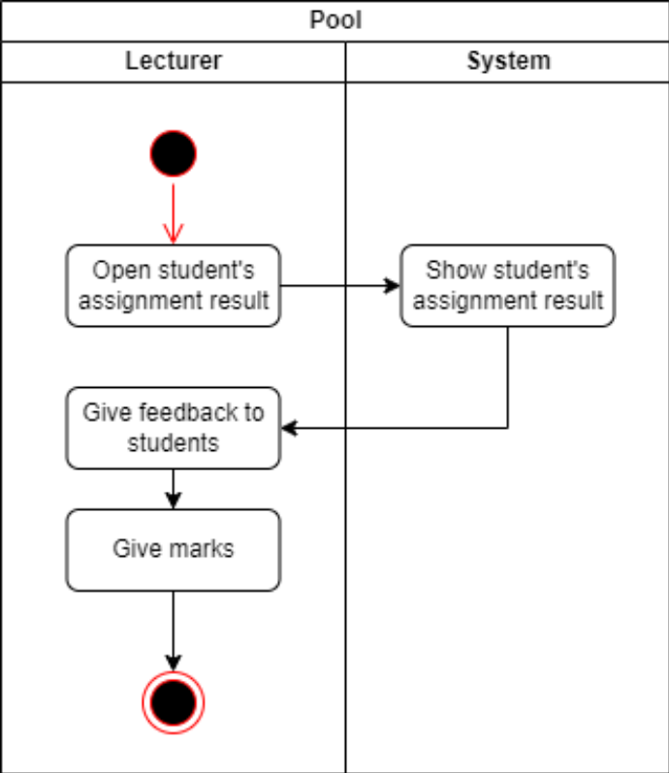
Activity Diagram
creating a topic, creating learning materials, and create file test.

Slide 13
IMPLEMENTATION AND TESTING
Limitations of Implementation
1. Development of tasks using Google Colaboratory.
2. Application testing is done using Codewars_test framework.
5.2 Learning Implementation
Data Analytics Learning Modul
Test file using Codewars_test for validation

Slide 14
Modul Descriptions
No | Experiment Name | Topic | Description
1. | Get the dataset from url and read as CSV file. | Data Loading | Students were given an experiment to access data sets from external sources into the system. Using this function pd.read_csv(url)
2. | Display the Produk Online Store Data. | Data Loading | Students are given an experiment to delete data columns that are not needed in the data analysis process. Display 5 first rows in the dataset using head_rows().
3. | Cleaning column name for real estate data. | Cleaning Dataset | Students were given an experiment to tidy up the column name arrangement to make it uniform. Delete the column using df.rename(columns=clean_names).
4. | Handling missing values for Calories data. | Cleaning Dataset | Students are given a practicum to handle missing values in a column and fill them with the column's mean value using the fillna() function.

Slide 15
Modul Descriptions
5. | Cutting a NumPy 2D array on a specific coverage. | Data Manipulations | Taking product-specific sales data and applying slicing to extract specific data on the Numpy 3D array.
6. | Calculate Total Product Revenue. | Data Manipulations | Calculating Total Product Revenue using the sum() function.
7. | Selecting Specific Movies from Movie dataset. | Data Manipulations | Analyses film datasets to find 10 films using argsort() and iloc() functions.
8. | Analisa Measures of Variability pada customer's Age. | Data Manipulations | Analisa Measures of Variability pada customer's Age using mean(), median(), std(), skew(), quantile(), and corr() function.

Slide 16
Modul Descriptions
9. | Electronic Sales Analysis: Understanding Sales Trends Through Measures of Central Tendency. | Data Manipulations | Electronic Sales Analysis: Understanding Sales Trends Through Measures of Central Tendency using mean(), median(), and mode() function.
10. | Visualizing the age distribution of the population based on age range using a Pie Chart. | Data Visualization | analyze the age distribution of the population of a city by visualizing it using pie charts.

Slide 17
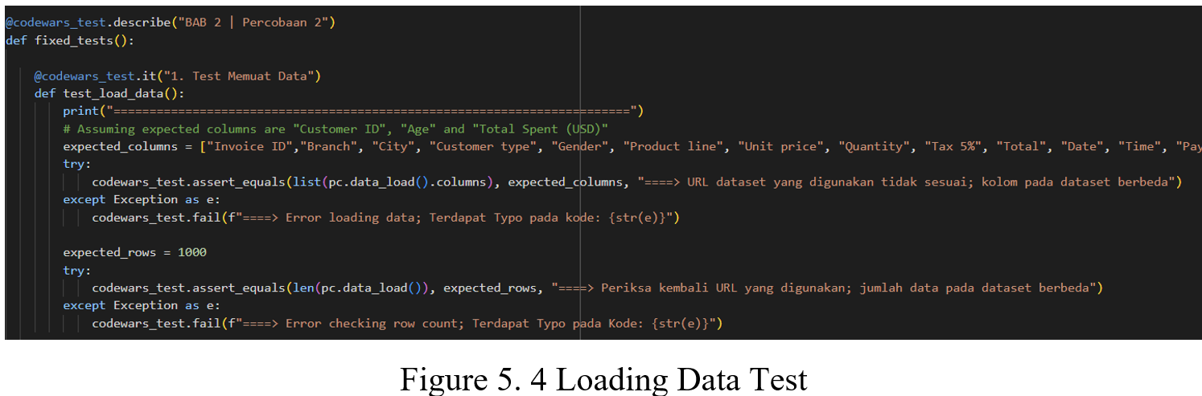
KODE TEST VALIDASI

Slide 18
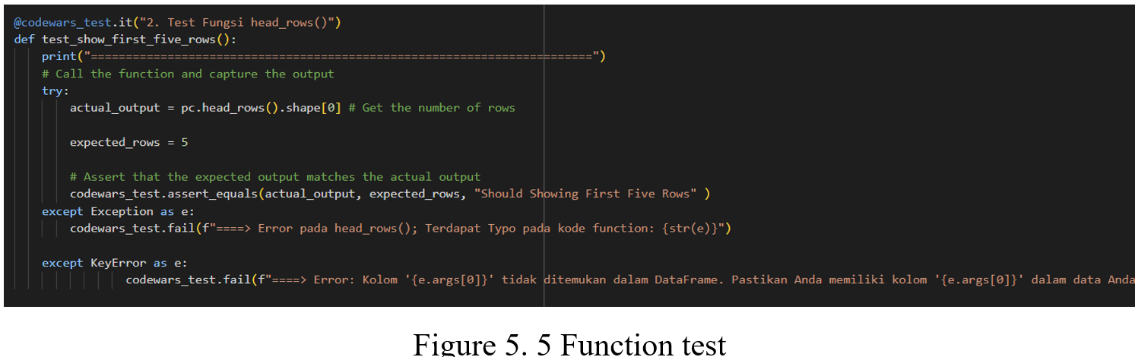
KODE TEST VALIDASI

Slide 19
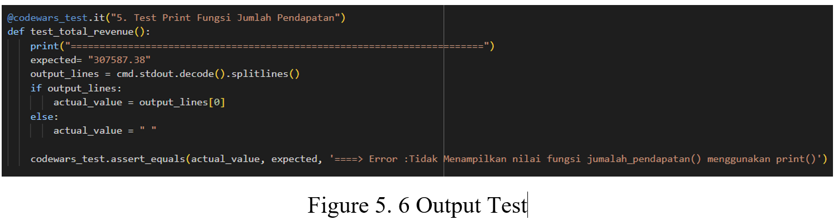

Slide 20
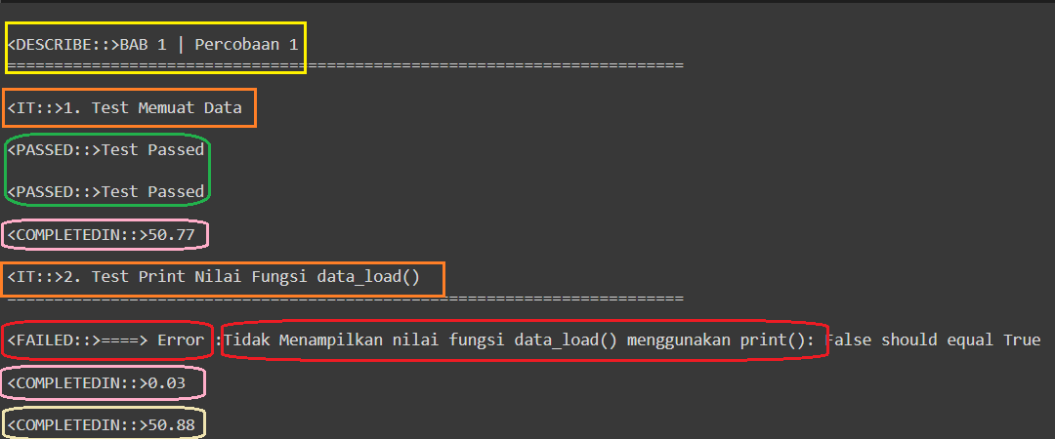
Validation Result Output

Slide 21
RESULTS AND DISCUSSION
40 students of the Faculty of Information Technology of the State Polytechnic of Malang as the participant
No | Name | NIM | Major
1 | Amalia Nuraini | 2041720160 | Jurusan Teknologi Informasi
2 | Elvira Sania Mufida | 2041720080 | Jurusan Teknologi Informasi
3 | Rabiatul Fitra Aulia | 2041720154 | Jurusan Teknologi Informasi
4 | Neha Viranica Nauly | 2141764127 | Jurusan Teknologi Informasi
5 | Khofifah Amanda | 2041720119 | Jurusan Teknologi Informasi
6 | Shine Devi Oktaviana Ronix Syah Putri | 2041720065 | Jurusan Teknologi Informasi
7 | Lelyta salsabila | 1941720026 | Jurusan Teknologi Informasi
8 | Salwa Zhafira Pratiwi Wahyudi | 2041720138 | Jurusan Teknologi Informasi
9 | FAHREZA PRIMA HAKIM | 2041720210 | Jurusan Teknologi Informasi
10 | Nanda Shabrina Putri Kurnia | 2141762064 | Jurusan Teknologi Informasi
11 | Mohammad Izamul Fikri Fahmi | 2141720171 | Jurusan Teknologi Informasi
12 | Annisa Aulia Nadhila | 2041720023 | Jurusan Teknologi Informasi
13 | Yoby Ryaian Pratama | 2041720039 | Jurusan Teknologi Informasi
14 | Maulana Bintang I. | 2041720132 | Jurusan Teknologi Informasi
15 | Izzatun Nauly | 2041720166 | Jurusan Teknologi Informasi

Slide 22
RESULTS AND DISCUSSION
40 students of the Faculty of Information Technology of the State Polytechnic of Malang as the participant
16 | Deatrisya Mirela Harahap | 2041720013 | Jurusan Teknologi Informasi
17 | Iftitah Hidayati | 2041720006 | Jurusan Teknologi Informasi
18 | Hafidz Irwan M | 2141764079 | Jurusan Teknologi Informasi
19 | Ahmad Farrel Sirajudin Zaidan | 2041720238 | Jurusan Teknologi Informasi
20 | Della Jannata Febiana | 2041720034 | Jurusan Teknologi Informasi
21 | Eva Monika Septiana | 2141764017 | Jurusan Teknologi Informasi
22 | Hilda Khoirotul Hidayah | 2041720161 | Jurusan Teknologi Informasi
23 | Dherisma Hanindita Utami | 2041720018 | Jurusan Teknologi Informasi
24 | Yaldika Putra Sinaga | 2041720056 | Jurusan Teknologi Informasi
25 | Rifqi Alauddin Nur | 2041720169 | Jurusan Teknologi Informasi
26 | farah zulfa hamidah | 2041720069 | Jurusan Teknologi Informasi
27 | Andre Maulana Mustofa | 2041720211 | Jurusan Teknologi Informasi
28 | Abdulilah Ali Qaid Al-shabany | 2041720203 | Jurusan Teknologi Informasi
29 | Chan Paul Amol | 2041720202 | Jurusan Teknologi Informasi
30 | Amern Mohammed Ali Albaiti | 2041720204 | Jurusan Teknologi Informasi

Slide 23
RESULTS AND DISCUSSION
40 students of the Faculty of Information Technology of the State Polytechnic of Malang as the participant
31 | Muhammad Hafiz Sayyid Diangga | 2041720156 | Jurusan Teknologi Informasi
32 | Atmayanti | 2041720016 | Jurusan Teknologi Informasi
33 | Silvia Prada Aprilia | 2041720141 | Jurusan Teknologi Informasi
34 | Muhammad Ilham El Hakim | 2041720162 | Jurusan Teknologi Informasi
35 | Ibnu Khalis Rabbani | 20415720159 | Jurusan Teknologi Informasi
36 | Zaed Abdullah | 2141764148 | Jurusan Teknologi Informasi
37 | Akhmadheta Hafid Prasetyawan | 2041720221 | Jurusan Teknologi Informasi
38 | Mochammad Hairullah | 2041720074 | Jurusan Teknologi Informasi
39 | M. Thosin Yuhaililul Hilmi | 2141764032 | Jurusan Teknologi Informasi
40 | Hanif Widyantoro | 2141764039 | Jurusan Teknologi Informasi

Slide 24
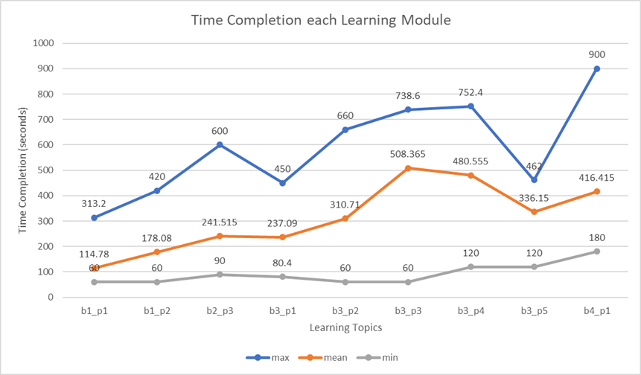
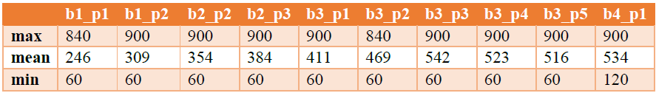
Student’s Completion Time
Table displays the outcomes of implementing the new teaching method on a group of 40 students. It is a graph of the results of the test based on the student's work time of each learning topic. The bottom green line indicates the fastest time a student has spent completing each learning topic, the red line shows the longest time the student has had spent finishing each learning subject, whereas the blue line between the green and red lines represents the average length of time it takes a student to complete each learning theme.

Slide 25
Student’s Completion Time
Results showed that all students successfully completed a series of tasks, albeit at varying times. Based on the average completion time for each module, the data analytics learning modules were categorized as shown in the table.
Level | Learning Stages
Easy | b1p1,b1p2
Medium | b2p3, b3p1, b3p2, b3p5
Hard | b3p3, b3p4, b4p1

Slide 26
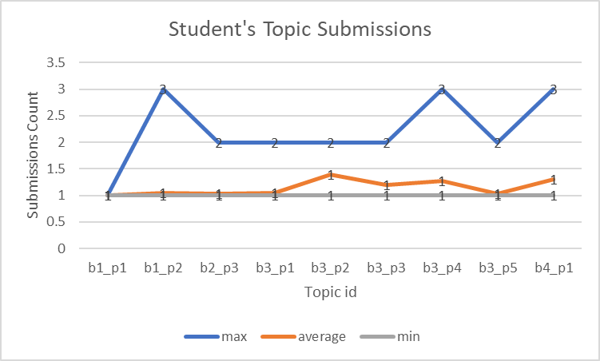
The difficulty level for each topic
From this figure, the submission counts vary across the topics. Some topics have received a high number of submissions, while others have received relatively few. maximum number of submissions for a single topic is 3. This indicates that some students are submitting multiple times for certain topics, which could be due to making revisions. The average number of submissions per topic falls between 1 and 2. This suggests that, on average, students are submitting 1-2 times per topic. The minimum number of submissions for a topic is 1. This means that there are no topics with zero submissions, and each topic has received at least one submission.

Slide 27
FEEDBACK MAHASISWA
The constructive suggestions gathered from student feedback are as follows:
The consistency of the language used in the module to use one language or make two versions.
The module should be more detailed. It doesn't matter if the sentences are long as long as they are detailed and easy to understand.
Perhaps the module presentation could be made more creative to make it a bit more colorful.
the guidance in the jobsheet needs to be clarified for better understanding.
Here are some examples of positive feedback we received from students:
It's good, because it's possible to know if the answers are right or wrong through testing.
the explanations and guides on the jobsheet make it very easy for the user to understand the material.
The jobsheet allowed me to learn independently about data analytics.
I hope it can be applied as a learning module"}.

Slide 28
Conclusion
The implementation of test-driven development (TDD) using Codewars_test in a Python programming learning context, as demonstrated with the 40 student participants from the Department of Informatics Engineering at Politeknik Negeri Malang, has yielded positive results. The provided module materials were found to be effective in facilitating students' understanding of data analytics concepts and guiding them through practical tasks. The positive feedback and suggestions provided by the students further validate the effectiveness of the learning system. Students provided 85.71% positive feedback. Their comments indicate that the module materials were clear, easy to follow, and helpful in facilitating independent learning.
The findings of this study suggest that the integration of TDD with Codewars_test in a data analytics learning assistance system can be a valuable approach for enhancing students' learning experiences and outcomes. By providing immediate feedback, encouraging a structured approach to problem-solving, and fostering independent learning, TDD can help students develop a deeper understanding of the underlying concepts and improve their coding skills.

